Slide 1



MobyDick An Interactive Multi-swimmer Exergame
Woohyeok Choi, Jeungmin Oh, Seongjun Kang, Miri Moon, Uichin Lee, Junehwa Song (KAIST)
Taiwoo Park (Michigan State University)
Inseok Hwang (IBM Research Austin)
Notes:
Thanks, session chair for introducing me.
Good afternoon. I’m glad to be here with you today.
As he said, I'm Choi, and working on a master’s degree in KAIST.
Today, I’m gonna introduce MobyDick, an interactive multi-swimmer exergame.

Slide 2
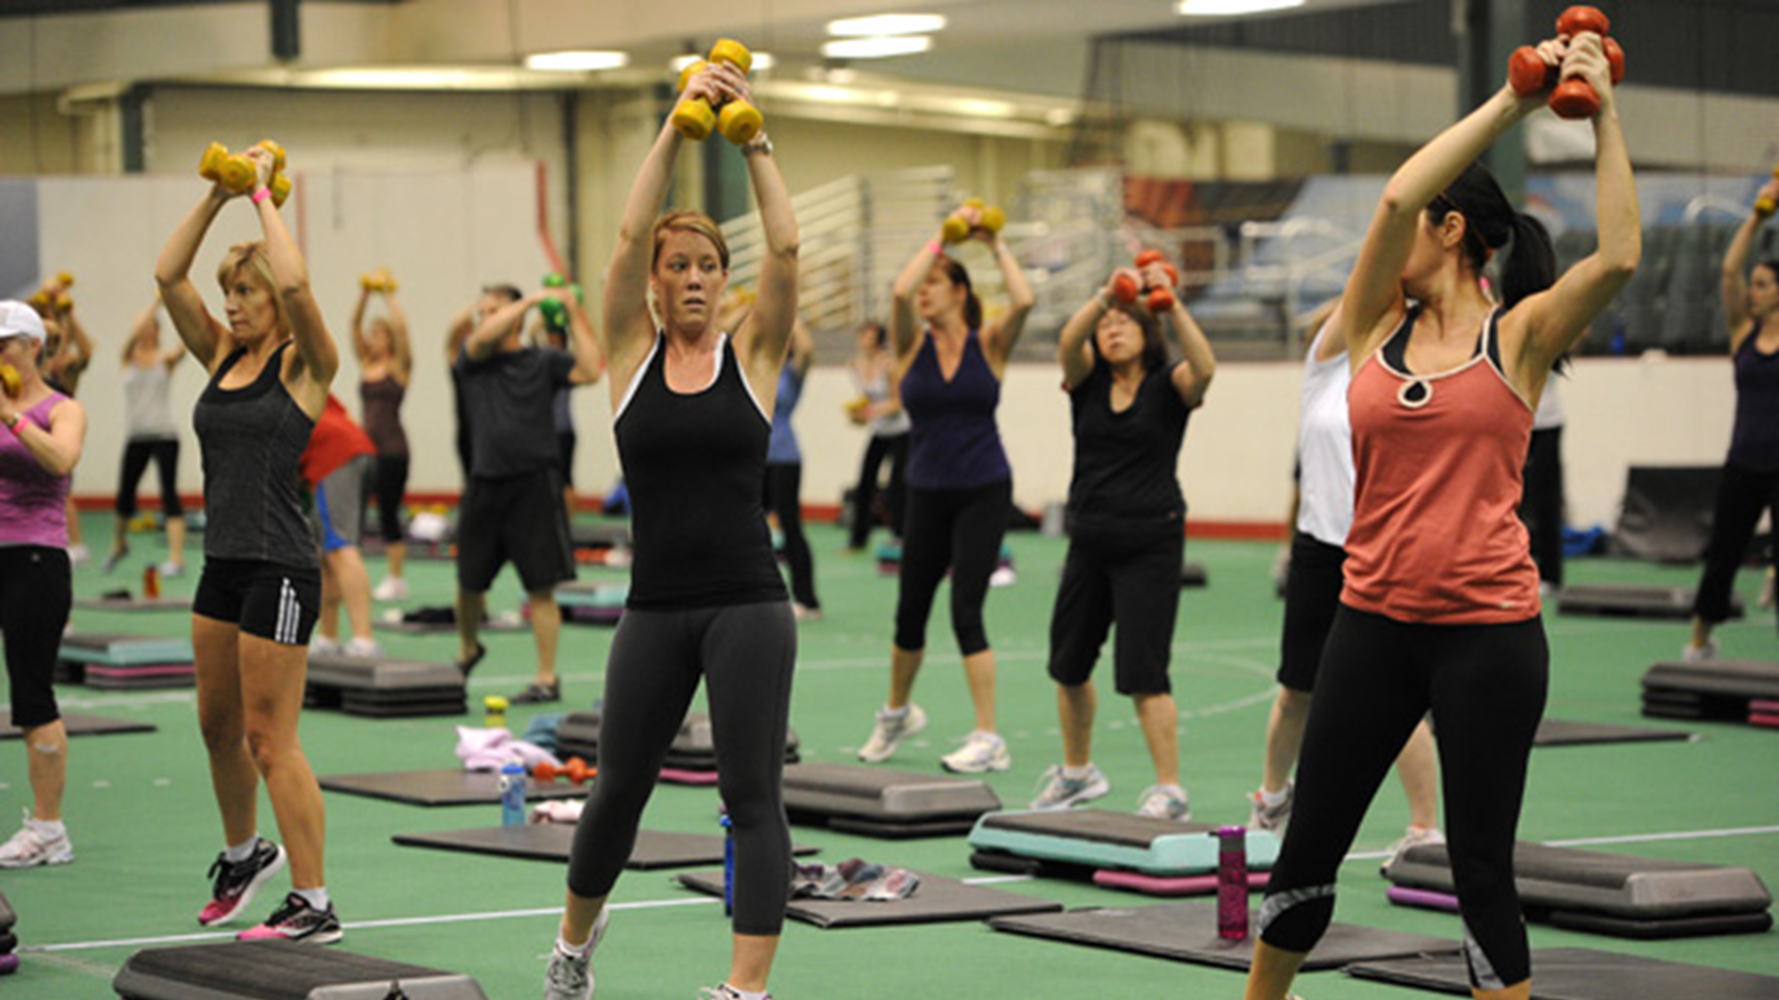
50%
of persons drop out of exercise
within
6months
Wilson & Brookfield, 2009
p1
Notes:
Nowadays, everybody knows the importance of an exercise, in order to prevent obesity.
However, according to the research, 50% of persons, drop out of an exercise, within 6 months. Why?

Slide 3
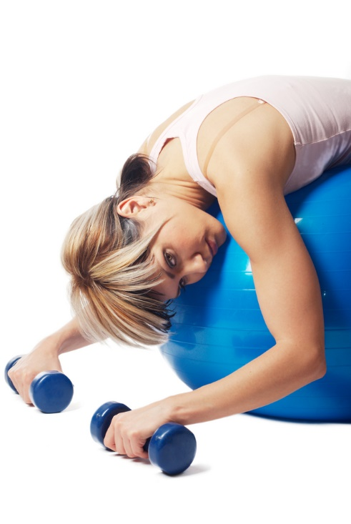




Drop-out
Reasons for
Exercise
Lack of
Social interaction
Motivation
Poor body image
Expense & Time
Len Kravitz
University of New Mexico
p2
Notes:
Kravitz, an exercise scientist, reported that the exercise dropout, results from
(click)
lack of social interaction
(click)
motivation,
(click)
and enough money and time to take an exercise, or something else.
In order to resolve those problems, especially,
(click)
lack of social interaction and motivation, there is a special research area, called Exertion Game, or Exergame.

Slide 4
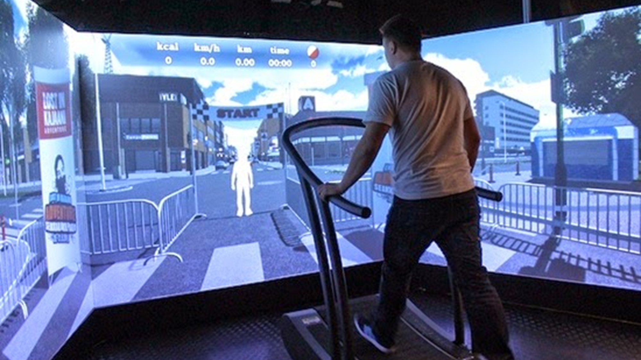
“A digital game where the outcome of
the game is predominantly determined
by physical effort.”
Florian Mueller
University of Melbourne
Exertion Game
p3
Notes:
Mueller, one of pioneering exergame researchers, defines an exergame as
(click)
“A digital game where the outcome of the game is predominantly determined by physical effort”.
In order words, an exergame is a virtual game, which adapts physical exertion, and that makes an exercise more enjoyable, thereby people are, motivated to continue it.

Slide 5

Adapting
exertion activities
▶PCGamerBike, Kinect Sports
p4
Notes:
The recent researches about exergame have emphasized two things.
The first one is that, exertion activities should be adapted to, exergame contents.
For example, in Kinect sports, the exergaming console, a user takes specific motions to play games, like shooting the ball in this picture.
In addition, some exergames have adapted, the speed or heart rate, which are the result, or body response of physical exertion.

Slide 6
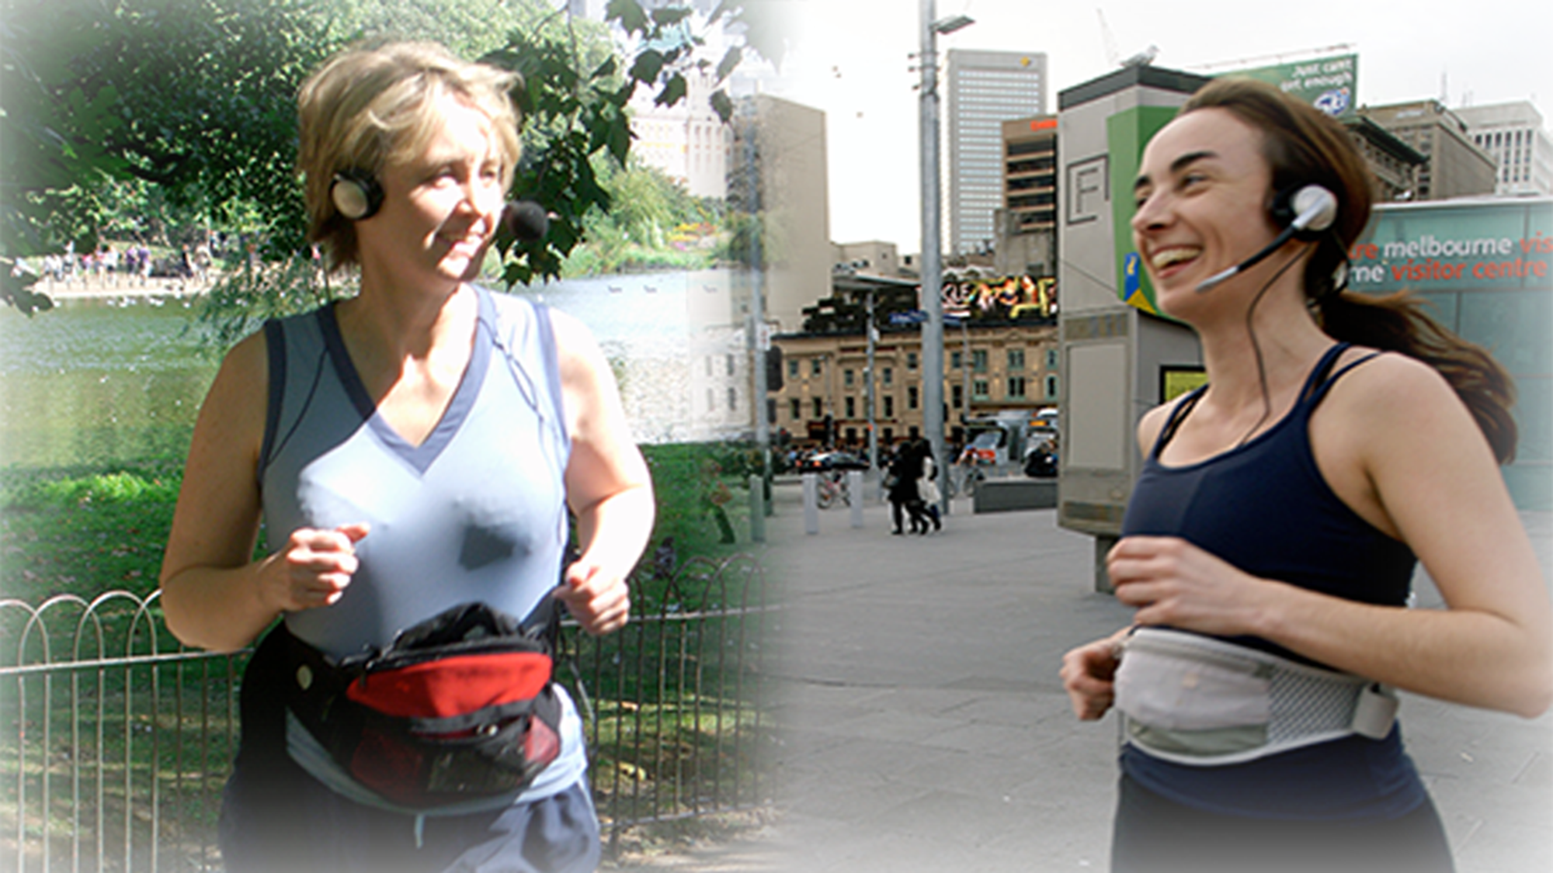
Supporting
social interaction
▶Jogging over Distance [CHI ‘07], Remote Impact [CHI ‘08]
p5
Notes:
Another one is to support social interaction.
There is a variety of related work, which ranges from, providing remote social interaction, like an exercise with distant users,
To, exploring a novel dimension of social interaction, while taking an exercise.

Slide 7
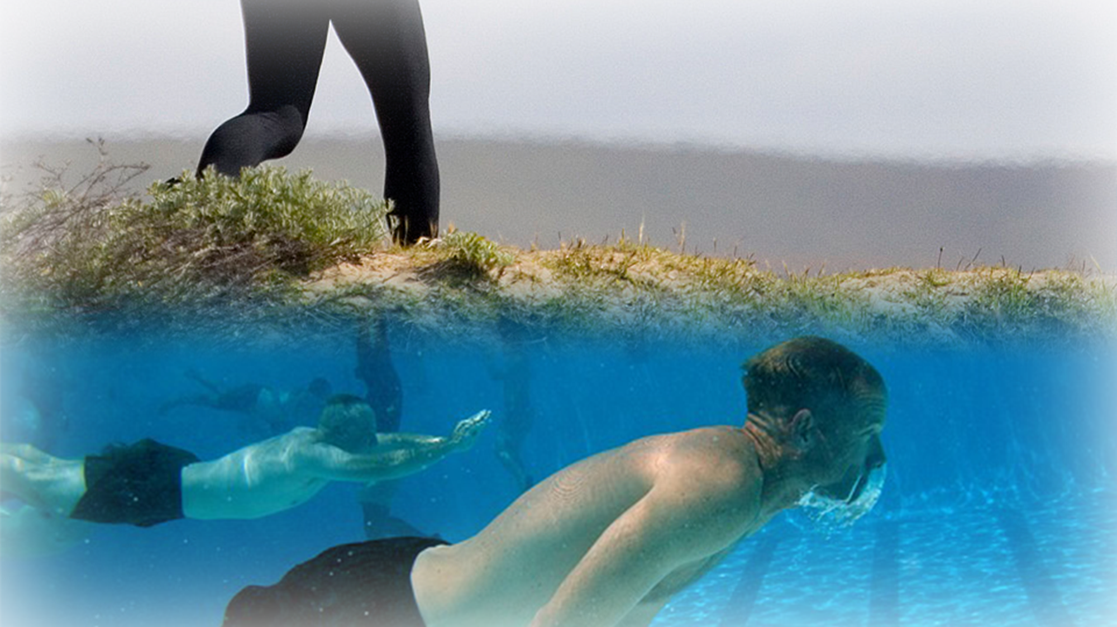
Ground-based exercise
▶Jogging, Cycling, Running…
Water-based exercise
▶Swimming, Snorkeling…
p6
Notes:
But, existing exergame researches have focused on ground-based exercise only, like jogging or cycling.
Instead of ground-based exercise, what if we design an exergame for water-based exercise?

Slide 8
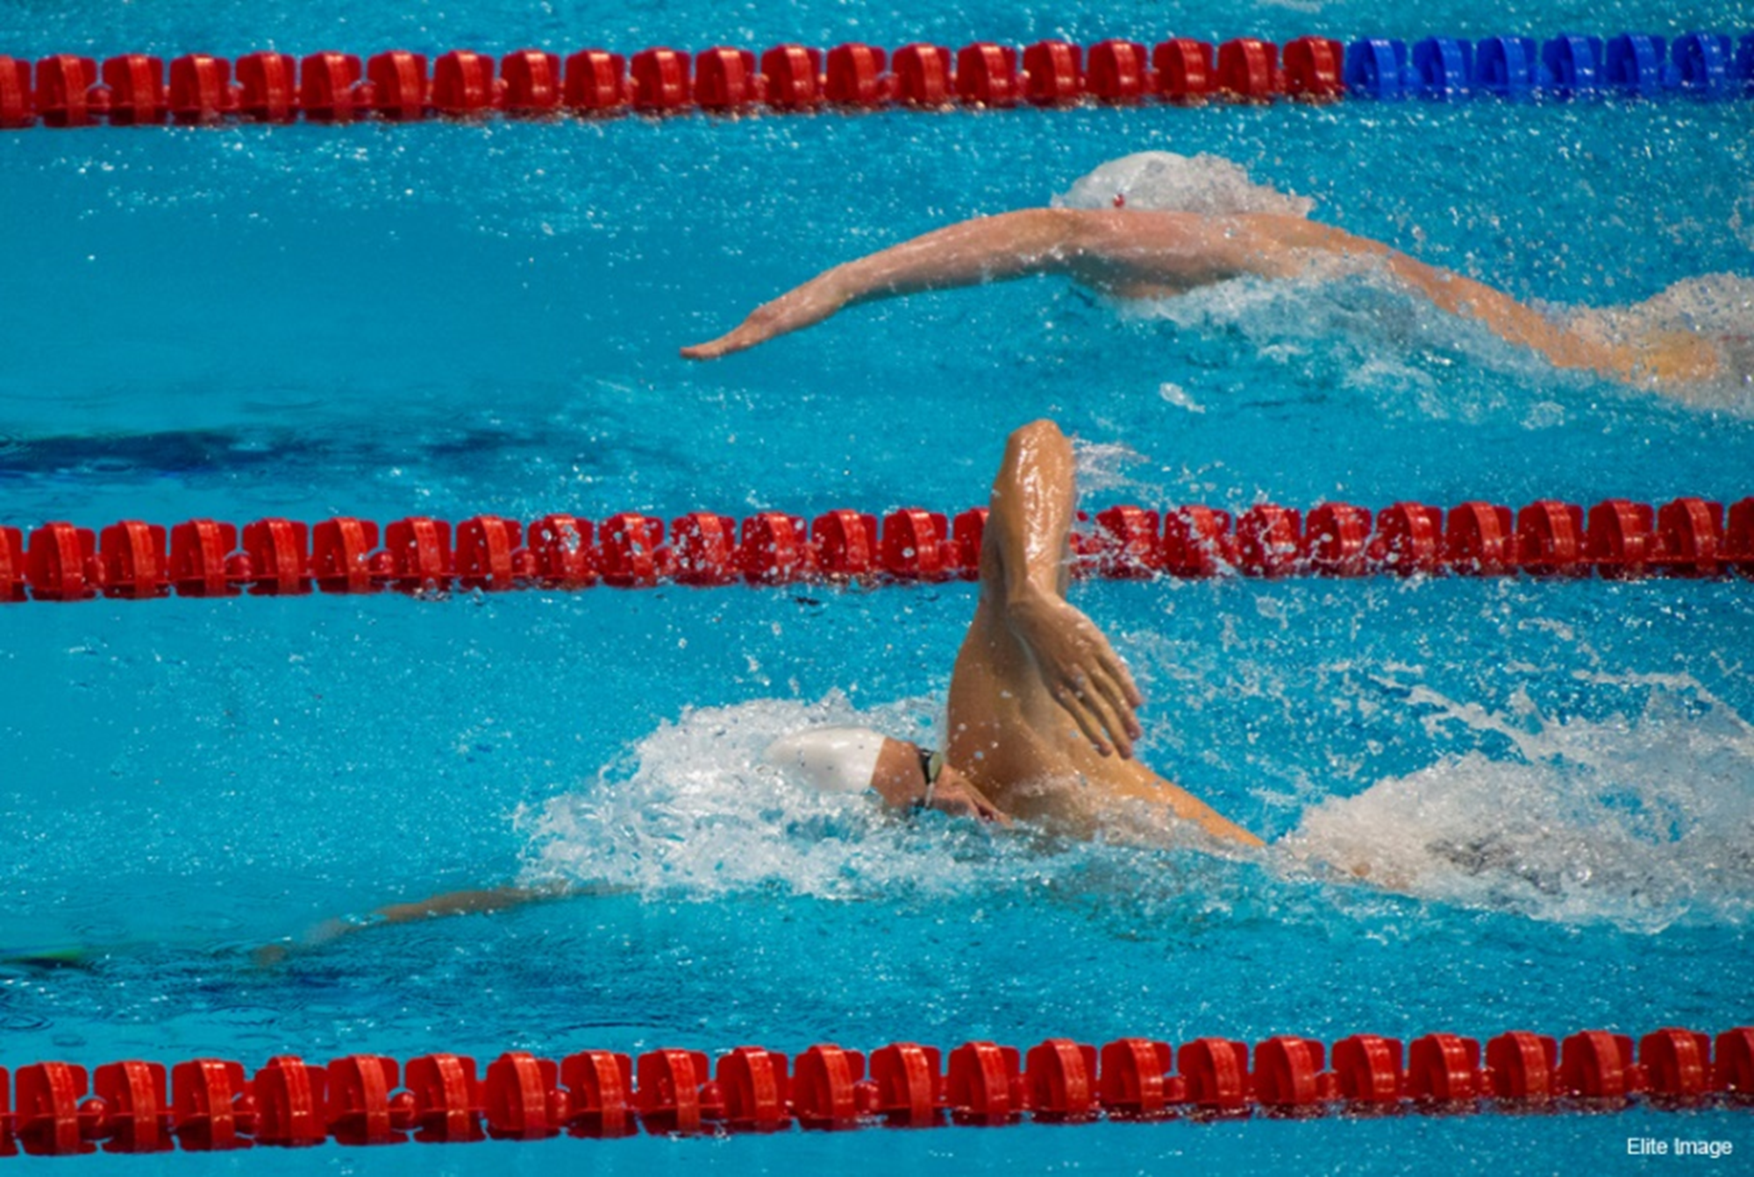
Transforming
swimming
activity into
multi-player
exergame
p7
Notes:
So, for swimming, which is one of the representative water-based exercises,
we aimed at transforming swimming activity into multi-player exergame, like next video clip.

Slide 9


Slide 10
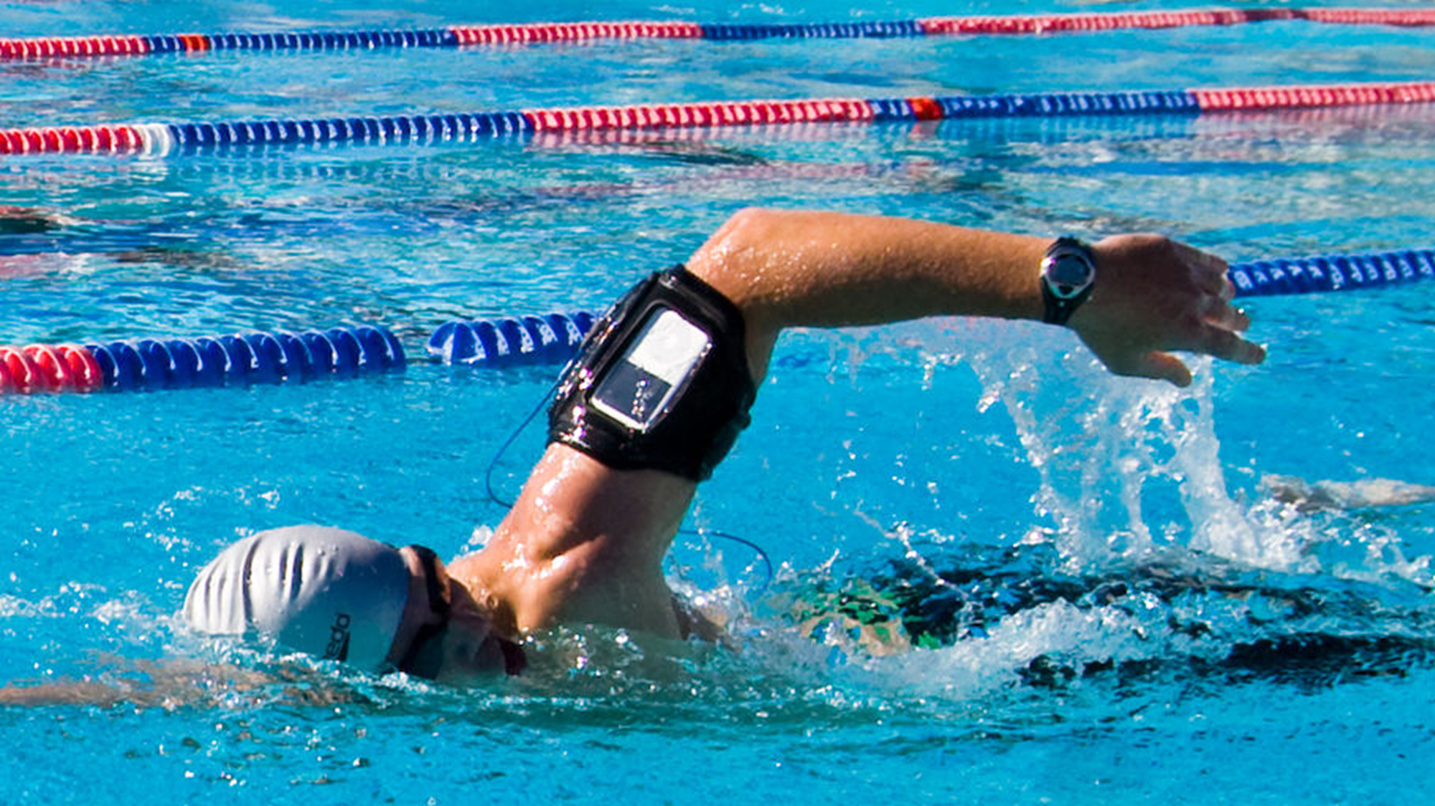

How to enable
wireless
communication
swimmers
among
p8
Notes:
Enjoy it?
As you can see, the goal of this game is that a group of swimmers have to defeat a virtual monster, Leviathan, using swimming styles in a limited time
In order to design this kind of a game, we specified several key challenges.
One of ‘em is how to enable wireless communication among swimmers under water, because of multi-play.

Slide 11
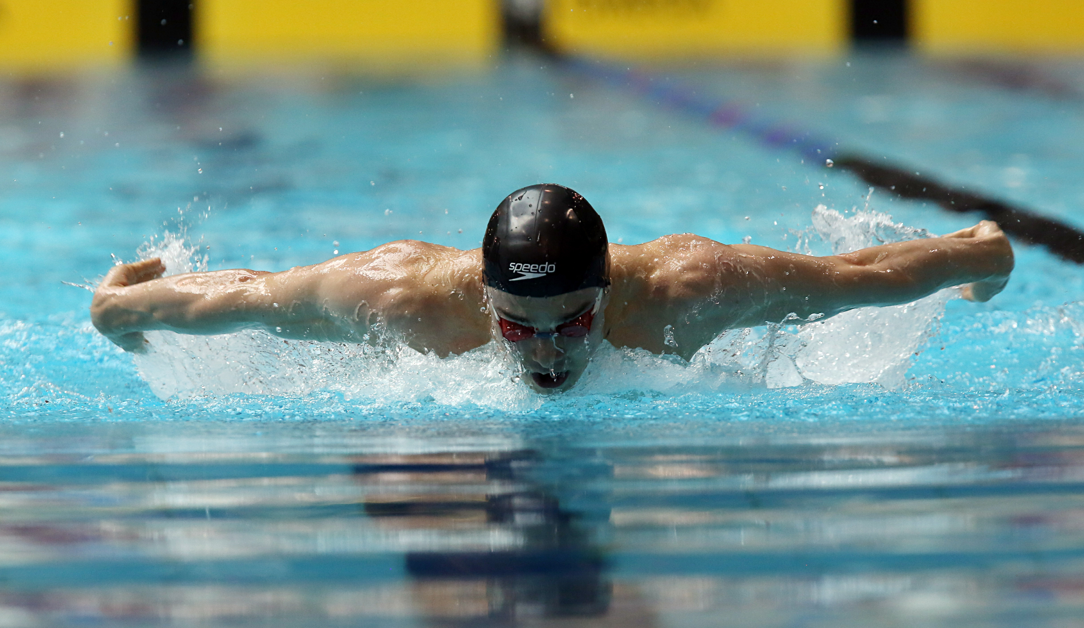
!!
How to recognize
swimming activity
real time
in
p9
Notes:
The second challenge is how to recognize swimming activity in real-time.
Swimming styles are used as game inputs,
so it is required to classify each swimming style, as well as to detect right time, when a user does each stroke, in order to give a sense of control and enough interactivity.

Slide 12
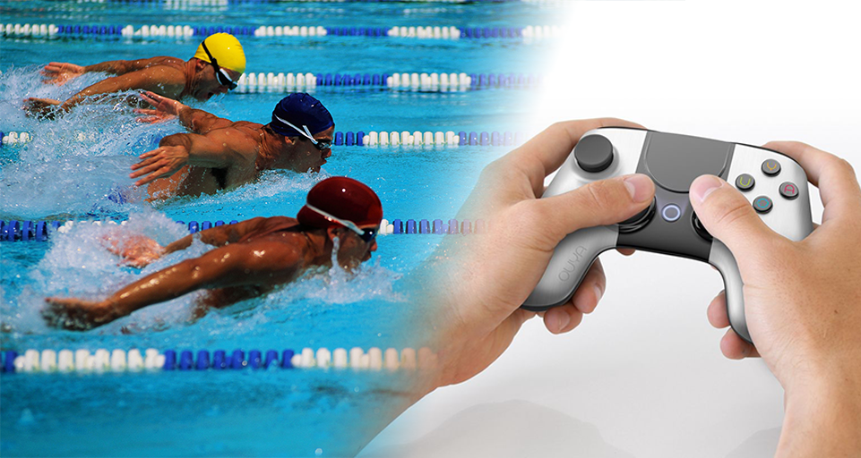


How to
design
exergame
an
swimming
considering
contexts
p10
Notes:
Final one is how to design an exergame for swimming.
When designing this kind of an exergame, we need to consider characteristics of swimming, like interaction modalities, motions, and something else.

Slide 13



Research Agenda
NETWORKING PERFORMANCE
IN THE POOL
SWIMMING
STROKE
RECOGNITION
GAME DESIGN
AND
USER STUDY
How to enable wireless communication
among swimmers
How to recognize
swimming activity
in real time
How to design
an exergame considering
swimming contexts
Notes:
Here is an overview about how we resolve each challenge.
(click)
In the first part of this presentation, Networking Performances in the Pool, I’ll show our comparative analysis of networking performance with popular network technologies in aquatic environments.
(click)
And then, I’ll explain how we recognize swimming styles in real time, in Swimming Stroke Recognition part.
(click)
In the final part of this presentation, Game Design & User Study, I’ll introduce some of our game designs, which results from our consideration of swimming contexts, as well as networking performance under water, and swimming stroke recognition.

Slide 14
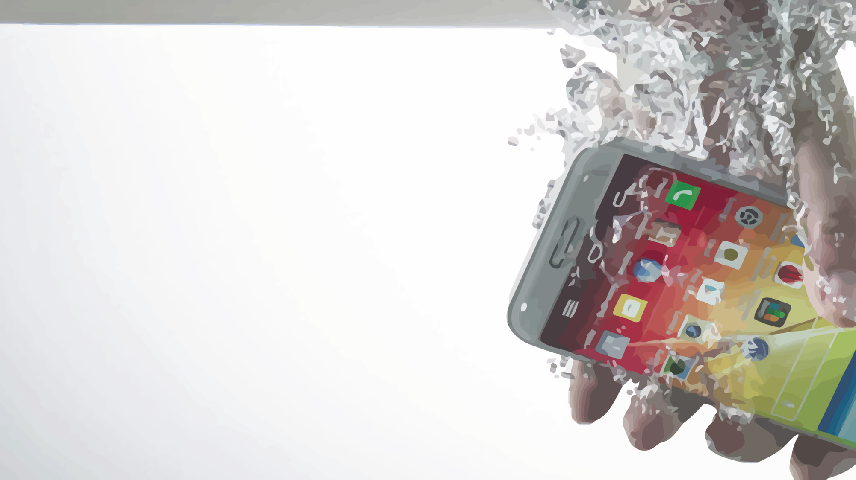
1. Networking
Performance
in the
Pool
▶Network performance by water depth
▶Network reconnection time
▶Network performance by swimming styles
Notes:
Now, let me begin the first part, Networking Performance in the Pool.

Slide 15
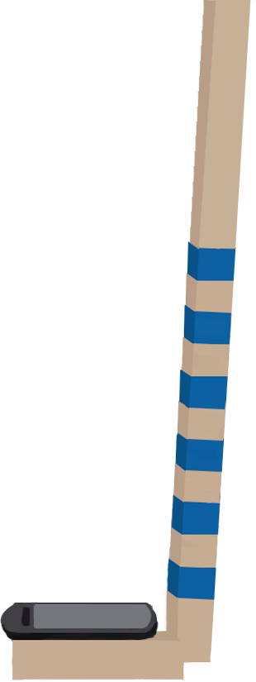

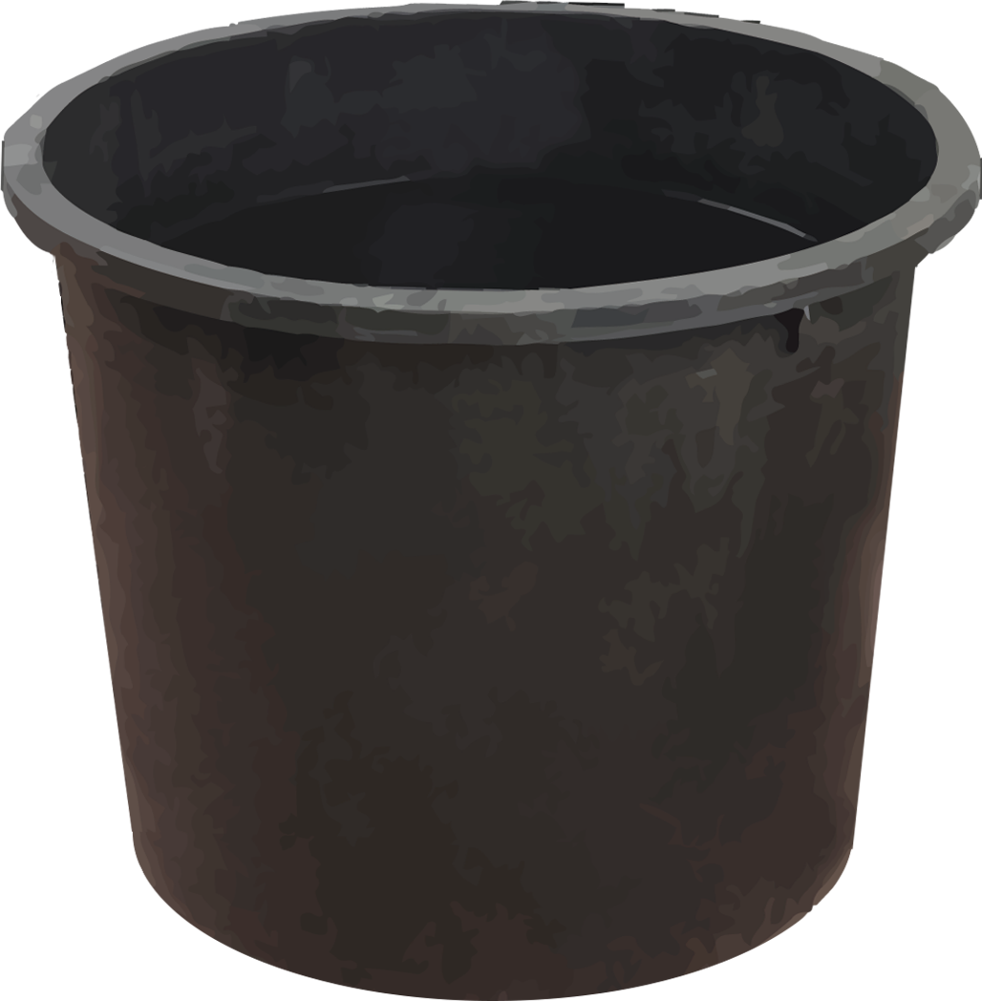
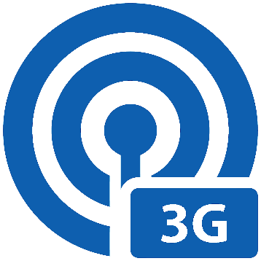



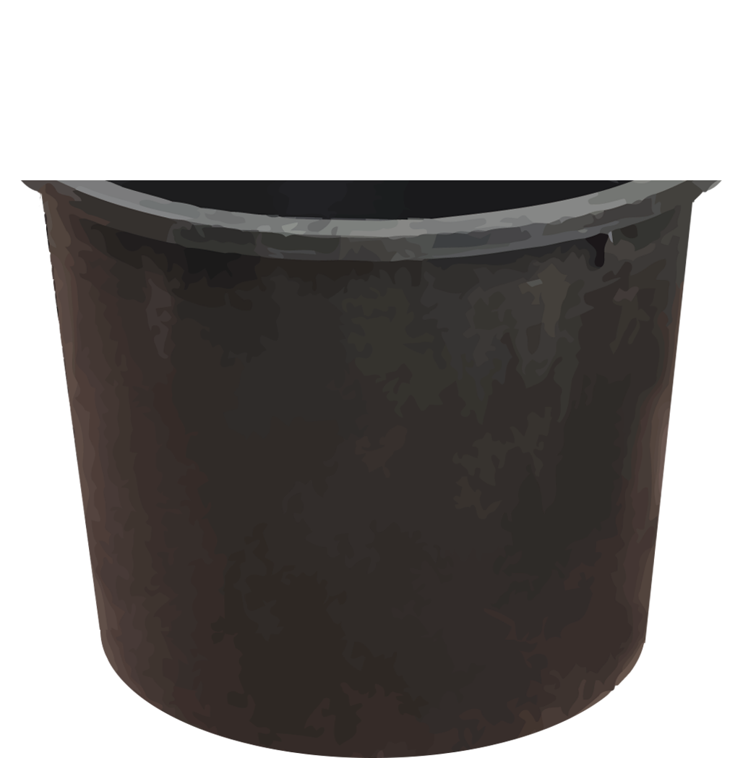
1. Networking Performance in the Pool
Experimental setup
1m
ISP
LG, KT
CL
Mode
2.4Ghz-B, G 5Ghz-AC, A/N
▶Round Trip Time
▶Packet Loss Rate
▶Received Signal Strength
UDP
Packet
1m
Tx Power
100%, 50%
p11
Notes:
In order to understand general performance changes, according to different water depths,
we chose, popular three wireless network technologies, such as 3G, LTE, and WiFi, and
measured Round Trip Time, Packet Loss Rate, and Received Signal Strength, for each of them.
(click)
In LTE measurements, we considered two ISPs, such as LG and KT, which are major cellular operators in Korea.
And, in WiFi measurements, we varied WiFi bandwidth, like 2.4Ghz and 5Ghz, and operation mode with, two different transmission power of AP.
(click)
In order to simulate a swimming pool, we prepared for the water container,
and poured water with, chlorine disinfectant, so that chlorine level of it, is similar to, that of a swimming pool.
(click)
and then, we mounted a smartphone, onto a wooden rod,
(click)
and immersed it into, the water container, as we increased, water depth in every 5 cm.
And UDP packets were exchanged, between a smartphone client and a server.

Slide 16

1. Networking Performance in the Pool
Network performance
water depth
by
2Ghz
800Mhz
2.4Ghz / 5Ghz
▶$Attenuation∝\sqrt{Frequency}$
WCDMA
OFDM
OFDM
▶Use of different modulation
p12
Notes:
Actually, we measured network performance with various settings, but in this presentation, I pick the Packet Loss Rate only.
In this graph, the horizontal axis means, water depth, and vertical axis means, Packet Loss Rate.
(click)
As you see, 3G network shows the lowest performance. Its packet loss rate is almost 100%, at a five-cm depth.
(click)
802.11G, the 2.4Ghz bandwidth WiFi, loses all the packets, at a fifteen cm depth,
(click)
LTE-KT, does at a 20cm depth.
(click)
And, LTE-LG shows the most robust performance.
WiFi 5Ghz, does not work at all, underwater.
In fact, when the packet loss rate reaches 100%, network is disconnected, so these points mean, the maximum depth that, connectivity is established.
(click)
Anyway, from these results, we concluded, 3G is not available under water.
(click)
Then, why does LTE show robust performance?
The 1st reason is that, LTE uses, the lower frequency bandwidth, than the others.
By beer-rambert’s law, the signal attenuation is, proportional to square root of frequency,
so LTE’s lowest frequency makes, its signal be, less attenuated, than the others.
(click)
The 2nd one is, the use of OFDM modulation.
While 3G’s WCDMA, uses a single wideband signal, OFDM use, multiple narrowband signals, and that makes network, more tolerant, in severe channel condition.

Slide 17

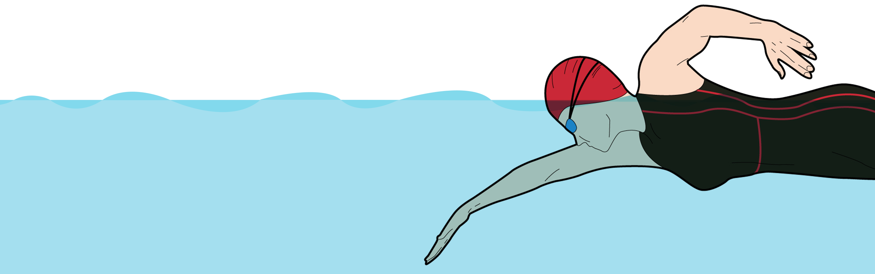
1. Networking Performance in the Pool
The depth of 20cm…?
Available
swimming?
while
Periodic emergence from water
Still poor channel conditions…
Disconnection
occur!
might
Submersion while freestyle
p13
Notes:
But, a 20cm depth, seems to be, unavailable while swimming.
To address this issue, we considered the, placement of devices.
(click)
Many literatures about, swimming with, sensor technology, have used, the back or abdomen, as a device placement,
cause those body parts represent bodily movement well.
(click)
But, those are submerged into water, while swimming a certain style.
For example, if a device is mounted onto an abdomen, it is completely submerged, while swimming freestyle.
Instead of those body parts,
(click)
we considered an arm, as the placement.
For every single stroke, an arm is periodically emerged from water, and, at that time, wireless communication, could be possible.
(click)
But, it’s true that, channel conditions are still poor, and network disconnection, might occur occasionally.
Therefore, we investigated, the latency of network reconnection, in LTE and WiFi.

Slide 18
1. Networking Performance in the Pool
Network reconnection time
LTE (LG)
3.2s
LTE
LTE (KT)
HSPA+
LTE
12.3s
UMTS
Immediately reconnect previous AP by caching AP info.
(e.g., BSSID, assigned IP)
WiFi
< 15s (AP scan interval)
<1s
3.1s
Disconnection!
p14
Notes:
In this graph, LTE shows different latencies, according to operators.
LG takes, three dot two, seconds to reconnect, but KT takes about, twelve, seconds.
That is because
(click)
LG tries to reconnect to, LTE link directly,
(click)
while KT goes through a, series of steps, like connecting UMTS, and then HSPA+, and then LTE link
(click)
In WiFi, actual reconnection time is, about three seconds.
But AP scanning is, always required for, reconnection, and the time interval of it, is up to, fifteen seconds.
So, reconnection time is totally, up to eighteen seconds.
To decrease WiFi reconnection time, we modified Android WiFi module, called, WPA_Supplicant.
In this modification, when disconnection occurs,
(click)
a smartphone immediately, tries to reconnect, previously connected AP, using cached AP information like, BSSID and assigned IP.
This technique omits, many steps such as waiting for AP scanning interval, actual scanning, and DHCP, so that, reconnection time is, reduced to under 1 second.
Anyway, among these network technologies, we removed
(click)
LTE-KT, due to the, longest reconnection time.
And, with LTE-LG and WiFi, we measured, network performance in a, real swimming scenario

Slide 19
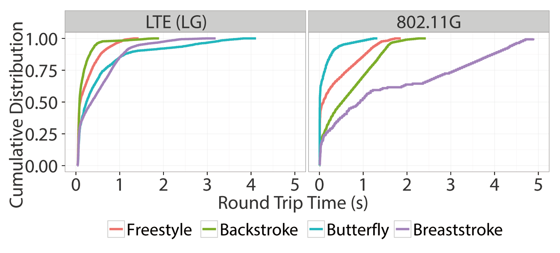


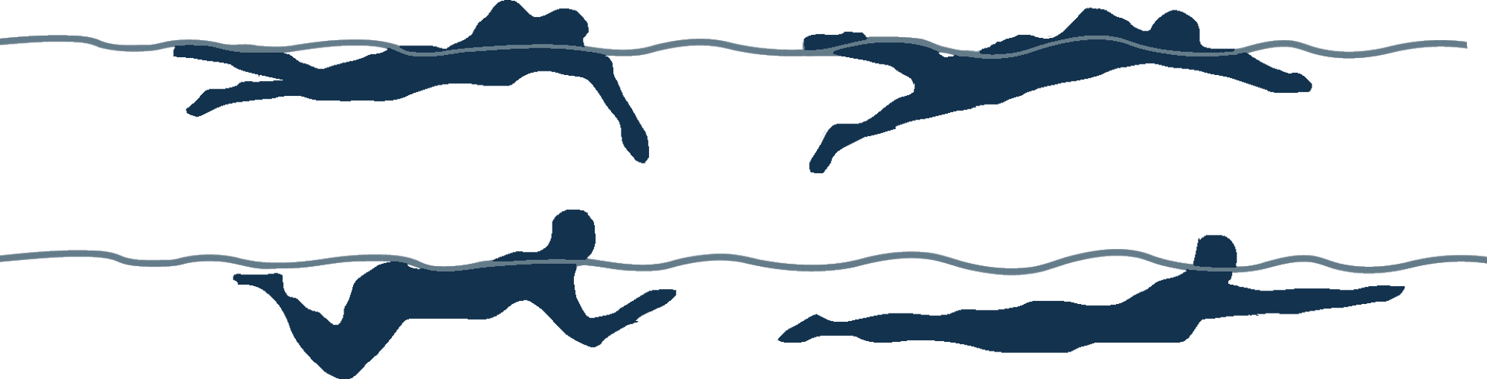
1. Networking Performance in the Pool
Network performance
swimming styles
in
Freestyle
PLR = 0.51
PLR = 0.73
Breaststroke
Overall PLR < 0.05
Deeper & longer submergence
Overall PLR > 0.3
p15
Notes:
This graph shows, cumulative distribution of, Round trip time for each swimming style in LTE and WiFi.
We could not found any significant RTT differences, between LTE and WiFi.
But, Packet Loss Rate is significantly different, between them.
(click)
Packet loss rate in LTE, is less than, 5%, but WiFi shows more than, thirty % of, packet loss rate.
(click)
Therefore, we concluded, LTE is the most robust under, swimming contexts.
Also, we found that, network performance, is largely influenced by swimming styles.
(click)
in LTE, Butterfly and breaststroke, shows higher RTT than the others.
(click)
in WiFi, also, breaststroke shows, the longest round trip time, and
Even if, butterfly seems to be good, in RTT distribution,
(click)
Its packet loss late, is over fifty %, so network performance is, largely degraded.
(click)
Such performance differences, result from different submergence patterns, of swimming styles.
(click)
When swimming breaststroke, an arm is submerged deeper, and longer than freestyle or backstroke,
and that makes channel condition severe, and performance, degradation.

Slide 20




1. Networking Performance in the Pool
LTE
SWIMMING STYLES
most robust under swimming contexts
significant performance variation
WATER DEPTH
RECONNECTION TIME
performance degradation /occasional disconnection
need enough time to re-establish connectivity
p16
Notes:
To sum up, LTE is most robust, under swimming contexts, and different water depth, and swimming styles, influence network performance.
In addition, it needs, enough time to re-establish connectivity.

Slide 21
Research Agenda
NETWORKING PERFORMANCE
IN THE POOL
SWIMMING
STROKE
RECOGNITION
GAME DESIGN
AND
USER STUDY
How to enable wireless communication
among swimmers
How to recognize
swimming activity
in real time
How to design
an exergame considering
swimming contexts
Notes:
Until now, I’ve discussed, networking performance in the pool, and now, I’ll introduce, the second part, swimming stroke recognition.

Slide 22
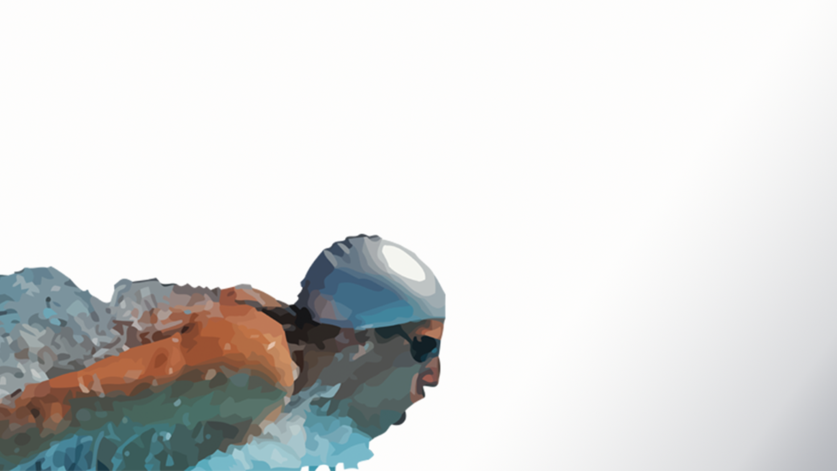
2. Swimming
Stroke
Recognition
▶Swimming style classification
▶Stroke timing detection
Notes:
This part is, composed of two, Swimming style classification and stroke timing detection.

Slide 23

2. Swimming Stroke Recognition
Intrinsic swimming activities
Swimming Styles
Stroke Timing
Freestyle
Backstroke
Breaststroke
Butterfly
p17
Notes:
Swimming is a full-body exercise, and requires, highly coordinated motions of, legs and arms,
so a swimmer cannot make an, additional gesture while swimming
Due to this, we just focused on, intrinsic activities of swimming, such as swimming styles.
(click)
Also, to give, right-time feedback, and enough interactivity to a swimmer, like this, we tried to, detect accurate stroke timing..

Slide 24
2. Swimming Stroke Recognition
StrokeSense
swimming styles& stroke timing recognition system
Accelerometer
/ Gyroscope
Barometer
Framing
Feature
calculator
Stroke timing
Game logic
Stroke timing detector
Features
Swimming styles classifier
Swimming
styles
p18
Notes:
For swimming style, and stroke timing recognition, we implemented StrokeSense.
This system classifies, four swimming styles, such as freestyle, backstroke, butterfly, and breaststroke, by using Accelerometer, and Gyroscope values,
(click)
And, it detects stroke timing, using barometer values.
Whenever stroke timing is detected, the latest classified style, is reported to game logic.

Slide 25
2. Swimming Stroke Recognition
Swimming styles classification
Effect
skill level differences
&
of
User-specific classifier
Training data
More difficult swimming styles
Same swimmer
Highly-trained swimmers
Swimming club members
Swimming styles classifier
Test data
Test data
Swimming club members
Additional participants
Highly-trained swimmers
Less-trained swimmers
98.0%
> 95%
60.7%
p19
Notes:
In swimming styles classification, we used, typical machine learning algorithm, like Support Vector Machine.
We built a classification model, using training data from campus swimming club members,
(click)
And, Its accuracy is 98%.
(click)
However, when we classified styles, with additional participants using this, classification model,
Its accuracy, decreases to 60.7%. Why these happen?
(click)
Using confusion matrices, we investigated, which of swimming style degrades accuracy.
(click)
Accuracy degradation, mostly results from classification of, breaststroke and butterfly.
Those two are, generally known as, more difficult swimming styles than the others
(click)
So, we conjectured, maybe, there are, swimming skill level differences, between these two groups.
Actually, swimming club members usually, participated in swimming drills, several times a week,
and some of them, aimed at amateur swimming competition.
But, additional participants, occasionally swim, not regularly.
(click)
So, their skill levels are relatively lower, than swimming club members, and we surmised, these skill level differences, could affect performance of classification model.
(click)
To resolve this problem, we proposed, user-specific classifier, which means each swimmer, builds, classification model, using own data.
Assuming that, swimming skill does not change, in a short time, a swimmer just needs to collect data. once in a few months.
(click)
Using user-specific model, accuracy for additional participants, increases over 95%, and we concluded that, user-specific model can cover larger group of swimmers.

Slide 26






2. Swimming Stroke Recognition
Stroke timing detection
using
barometer
10 – 15hPa
Required height/depth for
1hPa change
< 0.02hPa
7.9m
10 – 15cm
0.01m
p20
Notes:
Another part of StrokeSense, stroke timing detection, is based on peak detection technique, among continuous barometer values.
Ambient pressure, measuring by barometer, changes, significantly under water.
(click)
For example, in order to change 1hPa, we need to change the height, of about 8m in air, but under water, we need to change the, depth of 1 cm.
(click)
In our scenario, smartphone is mounted onto upper arm, that means, smartphone submerged into, and emerged from, water, up to 10 – 15cm.
(click)
When a swimmer draws a semicircle in air, pressure changes, less than one hundredth,
(click)
But when drawing a semicircle under water, pressure changes significantly, comparing to air.
(click)
We determined, stroke timing as the moment that, this local maximum point appears.
Interestingly, at this point, swimmers exert a strong muscular force, on their arm, so we can leverage this as, intuitive timing to provide feedback.
Also, this technique, does not care about, any swimming styles, or user differences, because, all of swimming styles, have similar stroke pattern, like drawing a circle in air, and under water.

Slide 27



2. Swimming Stroke Recognition
SKILL DIFFERENCES
BAROMETRIC
SENSOR
STROKESENSE
swimming styles & stroke
timing recognition system
user-specific swimming styles classification
stroke timing as peaks of barometric values
p21
Notes:
In summary, we implemented StrokeSense, which is swimming styles, and stroke timing recognition module.
In swimming styles classification, we suggested, user-specific classifier, in order to cover, larger swimmer groups.
and, in stroke timing detection, we used, peak detection technique, from continuous ambient, pressure values.

Slide 28
Research Agenda
NETWORKING PERFORMANCE
IN THE POOL
SWIMMING
STROKE
RECOGNITION
GAME DESIGN
AND
USER STUDY
How to enable wireless communication
among swimmers
How to recognize
swimming activity
in real time
How to design
an exergame considering
swimming contexts
Notes:
So far, I finished two parts. And from now on, I’ll introduce the final part, game design user study.

Slide 29

3. Game Design
User Study
&
▶Mapping swimming activities into the game
▶Multi-player collaboration with social awareness cues
▶Loss- and Latency-tolerant design
Notes:
In this part, I’ll show you, our game designs, considering, unique characteristics of swimming, and the some findings, from user study.

Slide 30
3. Game Design and User Study
Mapping
swimming activities
game
into the
p22
Notes:
To put exertion activities, into the game naturally, we mapped each swimming style, into a game command, considering behavioral characteristics of each style.
This video may help you understand our mapping intuition.
(click)

Slide 31
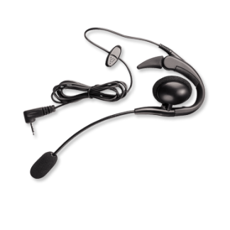




3. Game Design and User Study
Multi-player collaboration
with social awareness cues
Social awareness
Action
(e.g. , attack, evasion…)
Waterproof
wired earphones
MobyDick
Team-wide audio broadcast
Explicit communication
Status
(e.g. , health point, the member attacked)
p23
Notes:
Can you get the point?
Second design concern is how to support multi-player collaboration.
(click)
While swimming, a user cannot communicate with, each other, explicitly.
So, existing exergame scenario is not available in this situation.
(click)
Instead, MobyDick uses team-wide audio broadcast.
(click)
By using this, each user can know the other’s action like attack or evasion, and game status like health points of a monster, or the member, who is currently attacked.
Even if such a mediated communication, cannot deliver exact intention of a user,
(click)
it may provide social awareness to team members, so they might feel that, they swim with others.
Also, by sharing game status, we expected, each swimmer collaborates with other members, autonomously, in order to win a game.

Slide 32
3. Game Design and User Study
Loss-
Latency-tolerant design
and
You’re STUNNED!
Swim freestyle for recovery!
Your HP remains %
100
99
98
97
96
95
94
93
92
91
90
82
79
73
100
75
50
25
Decrease frequency of status updates
Swimming freestyle for network performance increase
p24
Notes:
Final one is Loss- & latency-tolerant design. .
As I previously mentioned, the water makes channel conditions poor, the design, to prepare for high packet loss or network disconnection, is required.
Therefore, we adapted various techniques and game design, but I’ll introduce just two game designs only..
(click)
The first one is to decrease frequency of status updates.
For example, assume that a game, notifies, a user’s HP in real time .
(click)
But, due to packet loss or network disconnection, the game could fail to notify current HP on time.
(click)
Then, users might feel strange and think the game does not work well.
(click)
Instead, if a game notifies HP infrequently like only in quartile, users might not be aware of any problem.
(click)
Second one is a design to deal with network disconnection.
If network is disconnected
(click),
maybe it happens while swimming breaststroke,
(click)
then game tells a user that, they have been stunned ,and recommends to swim freestyle for recovery.
As I mentioned in the networking part, freestyle guarantees relatively higher network performance than breaststroke, so network connectivity may be re-established.
Putting it all together, we implemented working prototype of MobyDick..

Slide 33

3. Game Design and User Study
User study
N=8
Pre-interviews
Game play
Intuitive behavioral metaphor
Making swimming enjoyable
“It cheers me up to hear that [Alpha and Bravo] are attacking when I am attacking too. I feel we are the same team indeed”.
“(When swimming without the game) usually it’s kind of boring.
[Playing the game] definitely took such feelings away from me.”
“When I freestyle or butterfly, it seems like hitting the water. (...) Backstroke seems like lying on the water and taking some rest.”
Focus group interviews
Individual
interviews
Transcription
Open coding
Topics
Socially enriched swimming experiences
p25
Notes:
And, to evaluate our game, we conducted user study with
(click)
8 participants.
Before playing MobyDick,
(click)
we conducted pre-interviews,
(click)
and then
they were divided into two four member-team, and each team played MobyDick two times, with 10 minutes of intermission.
(click)
After then, we conducted focus group interviews and individual interview.
(click)
All the interviews are recorded and transcribed,
(click)
and two researchers got main themes using open coding.
Among the themes, I just pick three.
(click)
One of ‘em is that our game makes swimming enjoyable.
One participant said she does not feel boring while playing the game, in contrast to, without game case
(click)
The second one is that our swimming style metaphor is intuitive.
They said freestyle and butterfly seems like attack, and backstroke seems like taking a rest.
(click)
Another one is that MobyDick enriches social interaction.
Participants said they feel team-bond, and cheered up when they did same actions, as other members’.

Slide 34


Future Work
SWIMMING STYLES
CLASSFICATION
EXERCISE INTENSITY
GROUP FITNESS
SWIMMING
general classification model considering the unique characteristics of swimming
adapting swimmer’s condition into the game
(e.g., heart rate)
explore novel social interactions in group fitness swimming
p26
Notes:
Through our preliminary experiences of MobyDick, we found some limitations and future work
In our swimming styles classification, we used user-specific model, but actually, general classification model, which means covering all the users using one model, is always preferable.
So, we need to improve this.
Also, our game inputs are swimming styles and stroke timing, but there are various exertion activities in swimming.
For example, adapting heart rate can make our game adjust exercise intensity.
Finally, we will explore novel social interactions under, group fitness swimming contexts.

Slide 35









Summary
NETWORKING PERFORMANCE
IN THE POOL
the most robust network under water: LTE
water depth degrades network performance
need enough time to reconnect
swimming styles influences network performance
SWIMMING
STROKE
RECOGNITION
swimming styles & stroke timing recognition
user-specific classification to cover skill level differences
stroke timing detection using barometric values
mapping swimming styles into game commands
multi-player collaboration with social awareness cues
loss- & latency-tolerant game design
GAME DESIGN
AND
USER STUDY
p27
Notes:
It’s a last slide. Let me wrap up with short summary.
(click)
We designed a multi-player exergame for swimming. For this, we performed a comparative analysis of networking performance under swimming contexts.
(click)
Also, we built real-time swimming styles and stroke timing recognition module, StrokeSense.
(click)
Finally, we designed MobyDick by carefully considering findings on networking and stroke sensing, as well as design constraints of underwater human communication.
That’s all, and thank you for, opportunity to be here, today.

